Slide 1
Respiratory Protection Programs Training
D. Joshua Cupriks, MS CIH, CSP
Antonio DeMartino Jr, CSP
TRC Engineering, Inc.
Notes:
Just to recap –
The purpose of this project is to conduct an IPC needs assessment among staff of group homes for individuals with intellectual and developmental disabilities (I/DD) in New York City (NYC), which have been significantly impacted by COVID-19.
Results from the survey and listening sessions will inform ongoing IPC capacity-building, resource development and support across these settings.

Slide 2
Training Overview
Infection Prevention Control Basics
General Requirements - OSHA Respiratory Protection Standard.
The specific circumstances under which respirators are to be used.
Respiratory hazards to which employees are potentially exposed during routine and emergency situations.
Notes:
Last Fall and Winter, we presented on the IPC LNA project at several DD Council meetings and also at IAC membership meetings.
Since then, we launched the survey in early February 2023 after receiving approval from Delia Tucker and James Doherty.
The survey was open for approximately seven weeks, and we received 41 completed surveys
The initial data analysis is complete and we’ll discuss some of the results on the next slides
We’re gearing up to launch Phase 2 of the project which are the listening sessions with frontline staff at OPWDD group homes

Slide 3
Training Overview
Why is the respirator necessary?
Recognize medical signs/symptoms that may limit or prevent effective respirator use.
Improper fit, usage or maintenance can compromise the protective effect of the respirator.
The limitations and capabilities of the respirators.
Notes:
Last Fall and Winter, we presented on the IPC LNA project at several DD Council meetings and also at IAC membership meetings.
Since then, we launched the survey in early February 2023 after receiving approval from Delia Tucker and James Doherty.
The survey was open for approximately seven weeks, and we received 41 completed surveys
The initial data analysis is complete and we’ll discuss some of the results on the next slides
We’re gearing up to launch Phase 2 of the project which are the listening sessions with frontline staff at OPWDD group homes

Slide 4
Training Overview
How to effectively use respirators, including in emergency situations and malfunctions.
How to inspect, don, remove, use, and check the respirator (for tight-fitting respirators such as N95 filtering facepiece respirators).
How safely dispose of a respirator that has been contaminated with chemicals or hazardous/infectious biological materials.
Notes:
Last Fall and Winter, we presented on the IPC LNA project at several DD Council meetings and also at IAC membership meetings.
Since then, we launched the survey in early February 2023 after receiving approval from Delia Tucker and James Doherty.
The survey was open for approximately seven weeks, and we received 41 completed surveys
The initial data analysis is complete and we’ll discuss some of the results on the next slides
We’re gearing up to launch Phase 2 of the project which are the listening sessions with frontline staff at OPWDD group homes

Slide 5
OSHA References
1910.134 Respiratory Protection
  1910.134
Appendix A – Fit Testing Procedures Mandatory
  1910.134AppA
1910.134(c) Respiratory Protection Programs
1910.134(e) Medical Evaluations
Notes:
Last Fall and Winter, we presented on the IPC LNA project at several DD Council meetings and also at IAC membership meetings.
Since then, we launched the survey in early February 2023 after receiving approval from Delia Tucker and James Doherty.
The survey was open for approximately seven weeks, and we received 41 completed surveys
The initial data analysis is complete and we’ll discuss some of the results on the next slides
We’re gearing up to launch Phase 2 of the project which are the listening sessions with frontline staff at OPWDD group homes

Slide 6
CDC Standard Precautions for All Patient Care – Infection Prevention Control Basics (Comprehensive Effort)
Hand Hygiene.
Utilize Personal Protective Equipment (PPE) whenever there is the expectation of possible exposure to infectious material.
Follow respiratory hygiene/cough etiquette procedures.
Ensure appropriate resident placement.
Notes:
Last Fall and Winter, we presented on the IPC LNA project at several DD Council meetings and also at IAC membership meetings.
Since then, we launched the survey in early February 2023 after receiving approval from Delia Tucker and James Doherty.
The survey was open for approximately seven weeks, and we received 41 completed surveys
The initial data analysis is complete and we’ll discuss some of the results on the next slides
We’re gearing up to launch Phase 2 of the project which are the listening sessions with frontline staff at OPWDD group homes

Slide 7
CDC Standard Precautions for All Patient Care – Infection Prevention Control Basics (Comprehensive Effort)
Properly clean and disinfect resident care equipment.
Clean and disinfect the environment.
Handle textiles and laundry carefully.
Follow safe injection procedures.
Ensure proper handling of needles and other sharps.
Notes:
Last Fall and Winter, we presented on the IPC LNA project at several DD Council meetings and also at IAC membership meetings.
Since then, we launched the survey in early February 2023 after receiving approval from Delia Tucker and James Doherty.
The survey was open for approximately seven weeks, and we received 41 completed surveys
The initial data analysis is complete and we’ll discuss some of the results on the next slides
We’re gearing up to launch Phase 2 of the project which are the listening sessions with frontline staff at OPWDD group homes

Slide 8
CDC Standard Precautions for All Patient Care – Infection Prevention Control Basics
The Respirator Protection Plan (RPP) document is one part of a disease prevention program that focuses on the safe and effective use of respirator equipment for staff.
There are other critical controls that aid in disease prevention, including building maintenance/upkeep, building equipment maintenance/upkeep and engineering controls (i.e., ventilation, negative pressurization and particulate removal).
Notes:
Last Fall and Winter, we presented on the IPC LNA project at several DD Council meetings and also at IAC membership meetings.
Since then, we launched the survey in early February 2023 after receiving approval from Delia Tucker and James Doherty.
The survey was open for approximately seven weeks, and we received 41 completed surveys
The initial data analysis is complete and we’ll discuss some of the results on the next slides
We’re gearing up to launch Phase 2 of the project which are the listening sessions with frontline staff at OPWDD group homes

Slide 9
General Requirements - OSHA Respiratory Protection Standard
OSHA’s hierarchy of controls requires the use of feasible engineering controls as the primary means to control air contaminants. Respirators are required when "effective engineering controls are not feasible, or while they are being instituted.“
Paragraph (a)(2) requires employers to provide employees with respirators that are "applicable and suitable" for the purpose intended "when such equipment is necessary to protect the health of the employee.“
The Respiratory Protection Program must designate a qualified program administrator to oversee the program.
The Respiratory Protection Program must provide respirators, training, and medical evaluations at no cost to the employee.
Notes:
Last Fall and Winter, we presented on the IPC LNA project at several DD Council meetings and also at IAC membership meetings.
Since then, we launched the survey in early February 2023 after receiving approval from Delia Tucker and James Doherty.
The survey was open for approximately seven weeks, and we received 41 completed surveys
The initial data analysis is complete and we’ll discuss some of the results on the next slides
We’re gearing up to launch Phase 2 of the project which are the listening sessions with frontline staff at OPWDD group homes

Slide 10
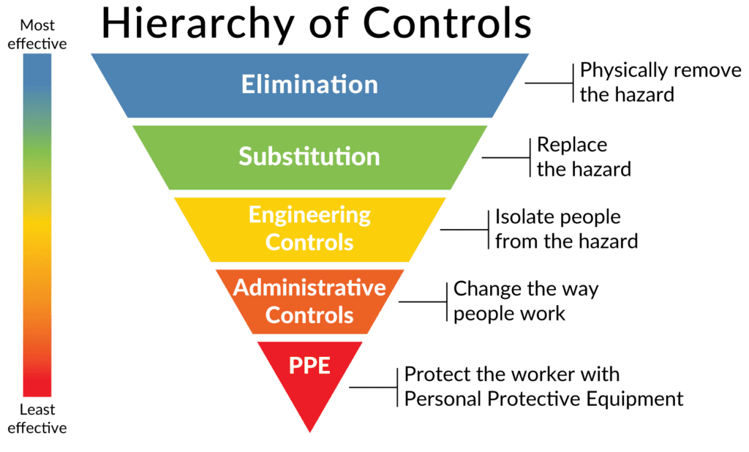
General Requirements - OSHA Respiratory Protection Standard
Notes:
Last Fall and Winter, we presented on the IPC LNA project at several DD Council meetings and also at IAC membership meetings.
Since then, we launched the survey in early February 2023 after receiving approval from Delia Tucker and James Doherty.
The survey was open for approximately seven weeks, and we received 41 completed surveys
The initial data analysis is complete and we’ll discuss some of the results on the next slides
We’re gearing up to launch Phase 2 of the project which are the listening sessions with frontline staff at OPWDD group homes

Slide 11
General Requirements - OSHA Respiratory Protection Standard
Why does my employer want me to wear a respirator?
  Protect oneself from airborne hazards
When to wear a respirator
  When your employer calls for it (ie COVID patient)
Notes:
Last Fall and Winter, we presented on the IPC LNA project at several DD Council meetings and also at IAC membership meetings.
Since then, we launched the survey in early February 2023 after receiving approval from Delia Tucker and James Doherty.
The survey was open for approximately seven weeks, and we received 41 completed surveys
The initial data analysis is complete and we’ll discuss some of the results on the next slides
We’re gearing up to launch Phase 2 of the project which are the listening sessions with frontline staff at OPWDD group homes

Slide 12
General Requirements - OSHA Respiratory Protection Standard
Must select a respirator certified by the National Institute for Occupational Safety and Health (NIOSH) which must be used in compliance with the conditions of its certification.
Must identify and evaluate the respiratory hazards in the workplace, including a reasonable estimate of employee exposures and identification of the contaminant’s chemical state and physical form.
Respirators for non-IDLH atmospheres: Employers must use the assigned protection factors (APFs) listed in Table 1 of the OSHA Standard to select a respirator that meets or exceeds the required level of employee protection.
Notes:
Last Fall and Winter, we presented on the IPC LNA project at several DD Council meetings and also at IAC membership meetings.
Since then, we launched the survey in early February 2023 after receiving approval from Delia Tucker and James Doherty.
The survey was open for approximately seven weeks, and we received 41 completed surveys
The initial data analysis is complete and we’ll discuss some of the results on the next slides
We’re gearing up to launch Phase 2 of the project which are the listening sessions with frontline staff at OPWDD group homes

Slide 13
General Requirements - OSHA Respiratory Protection Standard
Table 1 – Fit Factors
Type of respirator¹ ² | Quarter mask | Half mask/N-95 | Full facepiece | Helmet/hood | Loose-fitting facepiece
1. Air-Purifying Respirator | 5 | 10 | 50
2. Powered Air-Purifying Respirator (PAPR) |  | 50 | 1,000 | 25/1,000 | 25
Notes:
Last Fall and Winter, we presented on the IPC LNA project at several DD Council meetings and also at IAC membership meetings.
Since then, we launched the survey in early February 2023 after receiving approval from Delia Tucker and James Doherty.
The survey was open for approximately seven weeks, and we received 41 completed surveys
The initial data analysis is complete and we’ll discuss some of the results on the next slides
We’re gearing up to launch Phase 2 of the project which are the listening sessions with frontline staff at OPWDD group homes

Slide 14
General Requirements - OSHA Respiratory Protection Standard
Select a respirator for employee use that maintains the employee’s exposure to the hazardous substance, at or below the maximum use concentration (MUC).
The MUC is the upper limit at which the respirator is expected to provide protection. To calculate the MUC, multiply the APF of the respirator by the Occupational Exposure Limit (PEL, REL, or TLV). 10 (APF) x 0.1 (PEL) = 1 ppm (MUC).
Do not apply MUCs to hazardous conditions (IDLH); instead must use respirators listed for IDLH conditions.
The respirator selected shall be appropriate for the chemical state and physical form of the contaminant. For example, the N-95 respirators remove 95% of particulate matter only down to 0.3 microns (i.e., dust, fumes, mists, aerosols,smoke particulates, pollen, mold spores, bacteria, viruses and allergens over a single work shift.)
Notes:
Last Fall and Winter, we presented on the IPC LNA project at several DD Council meetings and also at IAC membership meetings.
Since then, we launched the survey in early February 2023 after receiving approval from Delia Tucker and James Doherty.
The survey was open for approximately seven weeks, and we received 41 completed surveys
The initial data analysis is complete and we’ll discuss some of the results on the next slides
We’re gearing up to launch Phase 2 of the project which are the listening sessions with frontline staff at OPWDD group homes

Slide 15
General Requirements - OSHA Respiratory Protection Standard
Tight-fitting respirators shall not be worn by employees who have facial hair or any condition that interferes with the face-to-facepiece seal or valve function.
Personal protective equipment shall be worn in such a manner that does not interfere with the seal of the facepiece to the face of the user.
Employees shall perform a user seal check each time they put on a tight-fitting respirator using the procedures in mandatory Appendix B-1 or equally effective manufacturer’s procedures.
Notes:
Last Fall and Winter, we presented on the IPC LNA project at several DD Council meetings and also at IAC membership meetings.
Since then, we launched the survey in early February 2023 after receiving approval from Delia Tucker and James Doherty.
The survey was open for approximately seven weeks, and we received 41 completed surveys
The initial data analysis is complete and we’ll discuss some of the results on the next slides
We’re gearing up to launch Phase 2 of the project which are the listening sessions with frontline staff at OPWDD group homes

Slide 16
General Requirements - OSHA Respiratory Protection Standard
Must clean and disinfect respirators using the procedures, or equally effective manufacturer's procedures at the following intervals:
As often as necessary to maintain a sanitary condition for exclusive use respirators,
Before being worn by different individuals when issued to more than one employee, and
After each use for emergency use respirators and those used in fit testing and training.
Notes:
Last Fall and Winter, we presented on the IPC LNA project at several DD Council meetings and also at IAC membership meetings.
Since then, we launched the survey in early February 2023 after receiving approval from Delia Tucker and James Doherty.
The survey was open for approximately seven weeks, and we received 41 completed surveys
The initial data analysis is complete and we’ll discuss some of the results on the next slides
We’re gearing up to launch Phase 2 of the project which are the listening sessions with frontline staff at OPWDD group homes

Slide 17
General Requirements - OSHA Respiratory Protection Standard
Retraining required annually and when:
  Workplace conditions change,
  There is a health concern related to use,
  New types of respirator are used, or
  Inadequacies in the employee’s knowledge or use indicates need.
The basic advisory information in Appendix D shall be provided to employees who wear respirators when their use is not required. This is present in the facility RPP.
Notes:
Last Fall and Winter, we presented on the IPC LNA project at several DD Council meetings and also at IAC membership meetings.
Since then, we launched the survey in early February 2023 after receiving approval from Delia Tucker and James Doherty.
The survey was open for approximately seven weeks, and we received 41 completed surveys
The initial data analysis is complete and we’ll discuss some of the results on the next slides
We’re gearing up to launch Phase 2 of the project which are the listening sessions with frontline staff at OPWDD group homes

Slide 18
General Requirements - OSHA Respiratory Protection Standard
Program Evaluation
Employer must conduct evaluations of the workplace as necessary to ensure proper implementation of the program and consult with employees to ensure proper use.
Recordkeeping
Records of medical evaluations must be retained and made available per 29 CFR 1910.1020.
A record of fit tests must be established and retained until the next fit test.
A written copy of the current program must be retained.
Notes:
Last Fall and Winter, we presented on the IPC LNA project at several DD Council meetings and also at IAC membership meetings.
Since then, we launched the survey in early February 2023 after receiving approval from Delia Tucker and James Doherty.
The survey was open for approximately seven weeks, and we received 41 completed surveys
The initial data analysis is complete and we’ll discuss some of the results on the next slides
We’re gearing up to launch Phase 2 of the project which are the listening sessions with frontline staff at OPWDD group homes

Slide 19

Staff/Medical Program
Requirements
Observations from work environment or fit testing indicates a need
Changes in the workplace increase the physiological burden on the employee
OSHA 29 CFR 1910.134(e)
Medical approval
Medical evaluation
Physician or Licensed Health Care Professional (PLHCP)
Notes:
OSHA requires 29 CFR 1910.134 (e) medical approval of any employee using a respirator. This involves conducting a medical evaluation prior to fit testing or requiring the employee to use a respirator in the workplace.
The employer must identify a physician or other professional licensed healthcare professional (PLHCP) to perform an initial examination and review the answers to a confidential medical questionnaire. Annual medical exams are not required unless:
The initial exam indicates the need for follow-up exams
The employee reports medical signs or symptoms related to the ability to use respirators
PLHCP, program administrator, or supervisor recommends reevaluation
Observations from work environment or fit testing indicates a need, and
Changes in the workplace increase the physiological burden on the employee
If the PLHCP determines that an employee's health may be placed at risk due to the use of a negative pressure APR; the employer is required to furnish a powered air purifying respirator to that employee - If the PLHCP determines the employee is capable of using such a respirator.

Slide 20
Staff/Medical Program Requirements
Must provide a medical evaluation to determine employee’s ability to use a respirator, before fit testing and use.
Must identify a physician or other licensed health care professional (PLHCP) to perform medical evaluations using a medical questionnaire or an initial medical examination that obtains the same information as the medical questionnaire (information required is contained in mandatory Appendix C).
Must obtain a written recommendation regarding the employee’s ability to use the respirator from the PLHCP.
Individuals with impaired lung function, due to asthma or emphysema for example, may be physically unable to wear a respirator.
Notes:
Last Fall and Winter, we presented on the IPC LNA project at several DD Council meetings and also at IAC membership meetings.
Since then, we launched the survey in early February 2023 after receiving approval from Delia Tucker and James Doherty.
The survey was open for approximately seven weeks, and we received 41 completed surveys
The initial data analysis is complete and we’ll discuss some of the results on the next slides
We’re gearing up to launch Phase 2 of the project which are the listening sessions with frontline staff at OPWDD group homes

Slide 21
Staff/Medical Program Requirements
Additional medical evaluations are required under certain circumstances:
  Employee reports medical signs or symptoms related to ability to use respirator;
  PLHCP, program administrator, or supervisor recommends reevaluation;
  information from the respirator program, including observations made during fit testing and program evaluation, indicates a need; or
  change occurs in workplace conditions that may substantially increase the physiological burden on an employee.
Annual review of medical status is not required.
Notes:
Last Fall and Winter, we presented on the IPC LNA project at several DD Council meetings and also at IAC membership meetings.
Since then, we launched the survey in early February 2023 after receiving approval from Delia Tucker and James Doherty.
The survey was open for approximately seven weeks, and we received 41 completed surveys
The initial data analysis is complete and we’ll discuss some of the results on the next slides
We’re gearing up to launch Phase 2 of the project which are the listening sessions with frontline staff at OPWDD group homes

Slide 22
Staff/Medical Program Requirements
Medical evaluations recap
  Questionnaire in appendix C
  MUST be reviewed by a PLHCP BEFORE fit test. Written recommendation
  1910.134(e)(3)(i)
    The employer shall ensure that a follow-up medical examination is provided for an employee who gives a positive response to any question among questions 1 through 8 in Section 2, part A of appendix C or whose initial medical examination demonstrates the need for a follow-up medical examination.
Notes:
Last Fall and Winter, we presented on the IPC LNA project at several DD Council meetings and also at IAC membership meetings.
Since then, we launched the survey in early February 2023 after receiving approval from Delia Tucker and James Doherty.
The survey was open for approximately seven weeks, and we received 41 completed surveys
The initial data analysis is complete and we’ll discuss some of the results on the next slides
We’re gearing up to launch Phase 2 of the project which are the listening sessions with frontline staff at OPWDD group homes

Slide 23
Fit Testing
All employees using a negative or positive pressure tight-fitting facepiece respirator at this facility must pass an appropriate qualitative fit test (QLFT).
Fit testing is required prior to initial use, whenever a different respirator facepiece is used, and at least annually thereafter.
  An additional fit test is required whenever the employee reports, or the employer or PLHCP makes visual observations of, changes in the employee’s physical condition that could affect respirator fit (e.g., facial scarring, dental changes, cosmetic surgery, or an obvious change in body weight).
The fit test shall be administered using an OSHA-accepted QLFT protocol, including for Isoamyl acetate, Saccharin, Bitrex and Irritant smoke
Notes:
Last Fall and Winter, we presented on the IPC LNA project at several DD Council meetings and also at IAC membership meetings.
Since then, we launched the survey in early February 2023 after receiving approval from Delia Tucker and James Doherty.
The survey was open for approximately seven weeks, and we received 41 completed surveys
The initial data analysis is complete and we’ll discuss some of the results on the next slides
We’re gearing up to launch Phase 2 of the project which are the listening sessions with frontline staff at OPWDD group homes

Slide 24
Who is required to wear Air Purifying Respirator (APR)?
Any and all staff who may be potentially exposed to airborne hazards. For this facility, the focus in on the protection from aerosols that may cause disease (i.e., SARS-CoV-2, tuberculosis, etc.) during both routine and potential emergency situations.
This includes staff supporting affected residents. Per the RPP, this list includes:
Physicians, NPs, ICNs, RNs/LVNs/LPNs, CNAs, medical techs., dieticians, facilities/cleaning staff, chaplain, palliative care/complimentary therapists, activities directors, social workers, cafeteria staff, managerial/admin. staff and direct service professionals (PT/OT/speech therapists, resp. therapists, psychologists)
As residents routinely intermingle with all facility staff (including managerial/administrative staff) in public and common areas, all staff is required to be fit tested for at least an N95 APR. Use of other NIOSH-approved respirators may be acceptable (i.e., P-100, PAPR).
Requirements for staff to don respirators who are not directly involved with patient care are dependent on aforementioned Federal, NYS DOH and NYC DOHMH criteria.
Notes:
Last Fall and Winter, we presented on the IPC LNA project at several DD Council meetings and also at IAC membership meetings.
Since then, we launched the survey in early February 2023 after receiving approval from Delia Tucker and James Doherty.
The survey was open for approximately seven weeks, and we received 41 completed surveys
The initial data analysis is complete and we’ll discuss some of the results on the next slides
We’re gearing up to launch Phase 2 of the project which are the listening sessions with frontline staff at OPWDD group homes

Slide 25
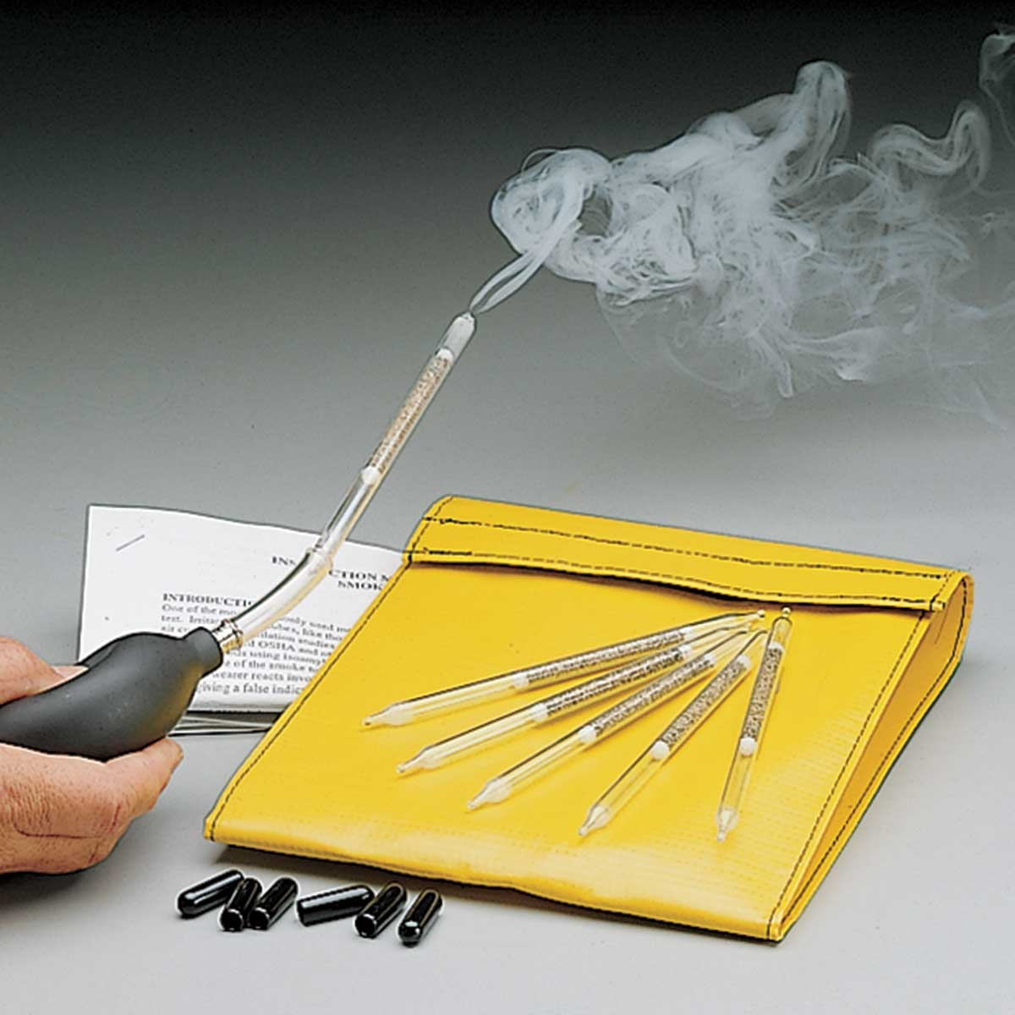
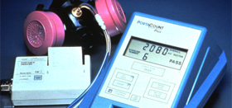
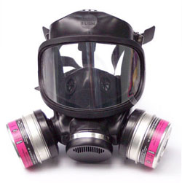
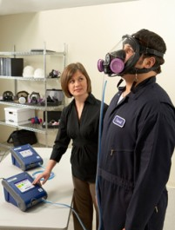
Respiratory Fit Testing
Type of FIT test
Date of FIT test
Employee/Identifier Info.
Employer
Sensitivity Check (i.e., Bitrex & Saccharin)
Style, make, model and size of the respirator
All N-95 for now
The person performing
the FIT test and the respirator wearer
Notes:
The tester must remember that the qualitative fit test is not an analytical measurement.
It is a subjective test where an irritant or aroma is used to determine is there is a good facepiece to face seal.
The type of fit test method conducted, the date the fit test was performed, the style, make, model and size of the respirator, the person who performed the fit test, and the printed name and signature of the respirator wearer must be documented and re-tested annually.

Slide 26
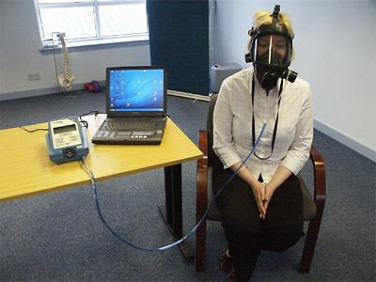
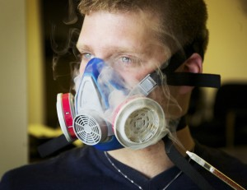
Respiratory FIT Testing (Examples)
Quantitative (Irritant Smoke, Sacharrin and Bitrex®)
Qualitative (i.e., particle counting to attain higher MUCs)
Notes:
There are two types of fit tests: quantitative and qualitative. The quantitative fit test provides a numerical fit factor that is specific to the individual wearing a specific respirator.

Slide 27
Proper Fit, Usage, and Maintenance of an APR
Ensure that fit testing is performed prior to wearing/donning the respirator. The following is required:
1. Proper medical evaluation required per 1910.134 per previous.
2. Fit testing/hands-on training per the RPP specification (See Companion Train the Trainer Program Guideline & Handouts)
Notes:
Last Fall and Winter, we presented on the IPC LNA project at several DD Council meetings and also at IAC membership meetings.
Since then, we launched the survey in early February 2023 after receiving approval from Delia Tucker and James Doherty.
The survey was open for approximately seven weeks, and we received 41 completed surveys
The initial data analysis is complete and we’ll discuss some of the results on the next slides
We’re gearing up to launch Phase 2 of the project which are the listening sessions with frontline staff at OPWDD group homes

Slide 28

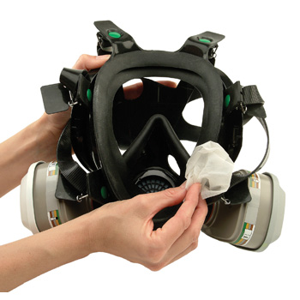
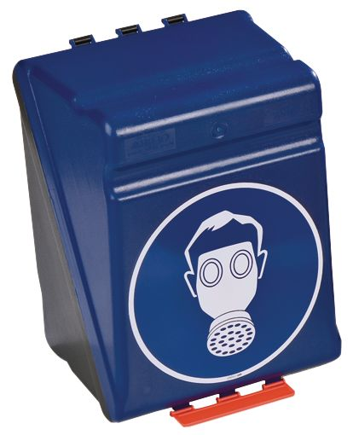
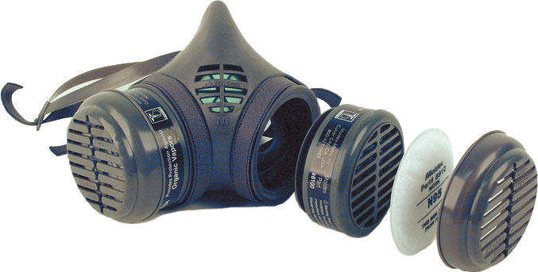
Respirator Maintenance
Inspection
Storage
Cleaning/Repair (Elastomeric only)
Notes:
(Woman) OSHA requires that any organization using respirators maintain a program for their care and cleaning.
The purpose of such a program is to assure that all respirators are maintained in a sanitary condition at their original effectiveness. If they are modified in any way, their NIOSH certification may be voided. The basis of the program should be the number and types of respirators, working conditions, and hazards involved.
In general, the program should include:
Inspection
Cleaning and disinfecting
Storage, and
Repair

Slide 29
Proper Fit, Usage, and Maintenance of an APR
Proper care, use and storage of a respirator will offer effective protection.
  It must be inspected prior to donning each time it’s worn. Be sure to inspect the condition of the various parts including, but not limited to, the facepiece, and head straps or PAPR connecting tubes or hoses, air flow, and batteries.
  It must be put on (donned) and worn properly. It must be performed according to the manufacturers’ instructions.
  These requirements are demonstrated during the hands-on & fit testing portion of the training.
  Be sure to keep your respirators on a clean, dry and secure area.
N95 Respirators – Putting it On:
  Put on your N95 with clean, dry hands.
  Inspect the N95 for damage before use. If it appears damaged, dirty, or damp, do not use it.
  Hold the N95 in your hand with the nose piece bar (or foam) at your fingertips. If yours does not have a nose piece, use the text written on it to be sure the top end is at your fingertips.
Notes:
Last Fall and Winter, we presented on the IPC LNA project at several DD Council meetings and also at IAC membership meetings.
Since then, we launched the survey in early February 2023 after receiving approval from Delia Tucker and James Doherty.
The survey was open for approximately seven weeks, and we received 41 completed surveys
The initial data analysis is complete and we’ll discuss some of the results on the next slides
We’re gearing up to launch Phase 2 of the project which are the listening sessions with frontline staff at OPWDD group homes

Slide 30
Proper Fit, Usage, and Maintenance of an APR
Putting on your N95 Respirator (Cont’d):
  Place the N95 under your chin with the nose piece bar at the top.
  Pull the top strap over your head, placing it near the crown. Then, pull the bottom strap over and place it at the back of your neck, below your ears. Do not crisscross the straps. Make sure the straps lay flat and are not twisted.
  Place your fingertips from both hands at the top of the nose piece. Press down on both sides of the nose piece to mold it to the shape of your nose.
Keep it Snug:
  Your N95 must form a seal to your face to work properly. Your breath must pass through the N95 and not around its edges. Jewelry, glasses, and facial hair can cause gaps between your face and the edge of the mask. The N95 works best if you are clean shaven. Gaps can also occur if your N95 is too big, too small, or it was not put on correctly.
Notes:
Last Fall and Winter, we presented on the IPC LNA project at several DD Council meetings and also at IAC membership meetings.
Since then, we launched the survey in early February 2023 after receiving approval from Delia Tucker and James Doherty.
The survey was open for approximately seven weeks, and we received 41 completed surveys
The initial data analysis is complete and we’ll discuss some of the results on the next slides
We’re gearing up to launch Phase 2 of the project which are the listening sessions with frontline staff at OPWDD group homes

Slide 31
Proper Fit, Usage, and Maintenance of an APR
Keep it Snug (Cont’d):
  Perform a negative pressure user seal check; the respirator user inhales sharply while blocking the paths for air to enter. A successful check is when the facepiece collapses slightly under the negative pressure.
  To complete a positive pressure user seal check, gently place your hands on the N95, covering as much of it as possible, then breathe out. If you feel air leaking out from the edges of the N95, or if you are wearing glasses and they fog up, it is not snug. Adjust the N95 and try again.
  If you cannot get a tight seal, refer to the manufacturer requirements or try a different size/style. Check for gaps every time you put on your N95.
Taking off your N95 respirator:
  1. After you remove your N95, wash your hands with soap and water, or hand sanitizer containing at least 60% alcohol if soap is not available.
Notes:
Last Fall and Winter, we presented on the IPC LNA project at several DD Council meetings and also at IAC membership meetings.
Since then, we launched the survey in early February 2023 after receiving approval from Delia Tucker and James Doherty.
The survey was open for approximately seven weeks, and we received 41 completed surveys
The initial data analysis is complete and we’ll discuss some of the results on the next slides
We’re gearing up to launch Phase 2 of the project which are the listening sessions with frontline staff at OPWDD group homes

Slide 32
Proper Fit, Usage, and Maintenance of a Respirator
When to replace your N95 respirator:
  Do not wash your N95 or put it in the oven or microwave to try to sterilize it. Replace the N95 when the straps are stretched out and it no longer fits snugly against your face or when it becomes wet, dirty, or damaged. Throw it in the trash. Where the respirator is believed to be contaminated with potentially hazardous biological waste or material(s), dispose of the N95 is an appropriate biohazard location. The current maximum expected use of an N95 respirator maintained in good condition is one (1) work shift.
Special Notes - Employees must leave the respirator use area:
  To adjust their respirator if the respirator is not fitting correctly or impeding their ability to work.
  To wash their face if the respirator is causing discomfort or rash.
  To change the respirator (i.e.., damaged, stained, wetted, etc.).
  To inspect the respirator if it stops functioning as intended.
Notes:
Last Fall and Winter, we presented on the IPC LNA project at several DD Council meetings and also at IAC membership meetings.
Since then, we launched the survey in early February 2023 after receiving approval from Delia Tucker and James Doherty.
The survey was open for approximately seven weeks, and we received 41 completed surveys
The initial data analysis is complete and we’ll discuss some of the results on the next slides
We’re gearing up to launch Phase 2 of the project which are the listening sessions with frontline staff at OPWDD group homes

Slide 33
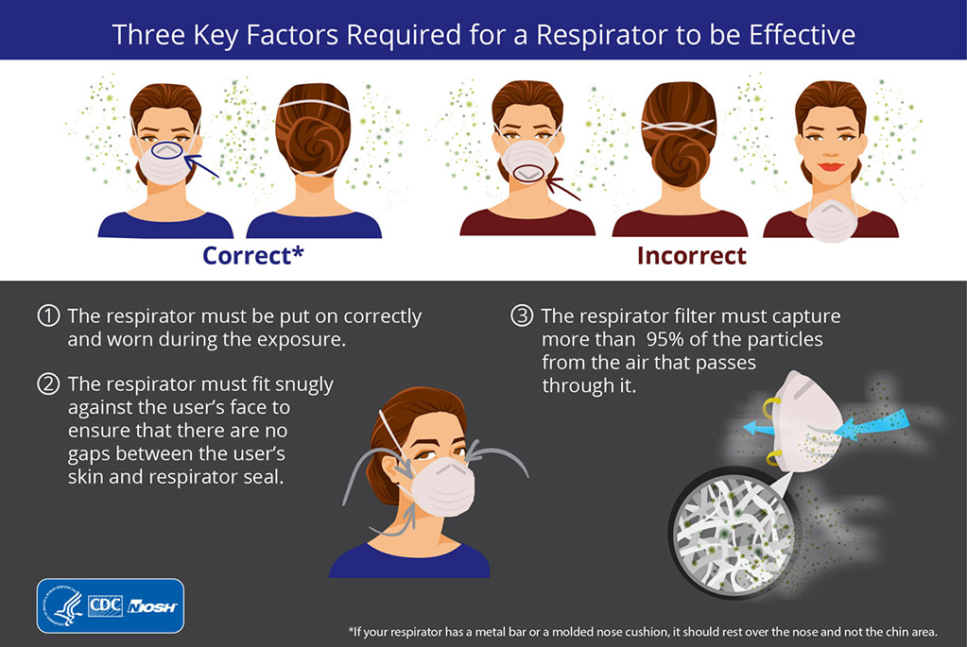
What does a proper fitting N-95 APR look like?
Notes:
Last Fall and Winter, we presented on the IPC LNA project at several DD Council meetings and also at IAC membership meetings.
Since then, we launched the survey in early February 2023 after receiving approval from Delia Tucker and James Doherty.
The survey was open for approximately seven weeks, and we received 41 completed surveys
The initial data analysis is complete and we’ll discuss some of the results on the next slides
We’re gearing up to launch Phase 2 of the project which are the listening sessions with frontline staff at OPWDD group homes

Slide 34
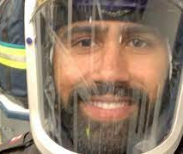
Other Types of APRs
(Supplemental Training to be Provided)
Powered-Air Purifying Respirator (PAPR)
Advantages
  Suitable for workers with facial hair.
  Configuration suitable for individuals with breathing challenges.
  Excellent protection.
  Many styles and designs.
Disadvantages
  Expensive.
  Routine cleaning & maintenance.
  Requires charging; limited battery life
Notes:
Last Fall and Winter, we presented on the IPC LNA project at several DD Council meetings and also at IAC membership meetings.
Since then, we launched the survey in early February 2023 after receiving approval from Delia Tucker and James Doherty.
The survey was open for approximately seven weeks, and we received 41 completed surveys
The initial data analysis is complete and we’ll discuss some of the results on the next slides
We’re gearing up to launch Phase 2 of the project which are the listening sessions with frontline staff at OPWDD group homes

Slide 35
Supplemental APR Information
Notes:
Last Fall and Winter, we presented on the IPC LNA project at several DD Council meetings and also at IAC membership meetings.
Since then, we launched the survey in early February 2023 after receiving approval from Delia Tucker and James Doherty.
The survey was open for approximately seven weeks, and we received 41 completed surveys
The initial data analysis is complete and we’ll discuss some of the results on the next slides
We’re gearing up to launch Phase 2 of the project which are the listening sessions with frontline staff at OPWDD group homes

Slide 36
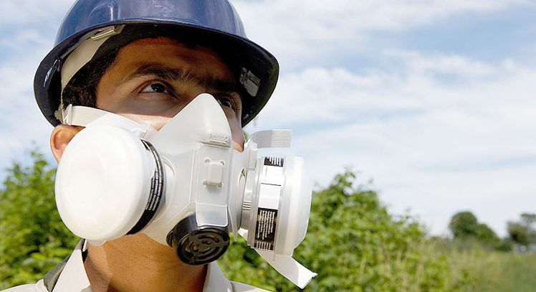
Optional Training - Tight Fitting APR Use
Particulates
Vapors/gases
Notes:
The filter media chosen for use in an APR must be appropriate for the form and state of the contaminant.
Respiratory hazards can be broken down into two basic classes: particulate and vapor/gases. An APR Is only effective if the filter element or chemical cartridge chosen is adequate in blocking or binding enough of the contaminant of concern to prevent exposure.

Slide 37
General APR Use
(Elastomeric Face Pieces/PAPR)
For the best protection from dusts, fumes or mists:
The APR shall be equipped with a high-efficiency particulate air (HEPA) filter (i.e., removal of 99.97% of particulate down to 0.3 microns).
For protection from gases and vapors:
The respirator must protect the health of the employee under routine and emergency requirements
The respirator must be appropriate for the chemical state and physical form of the contaminant
A means is available to determine when the cartridge must be changed
Notes:
Air purifying respirators only serve to reduce the concentration of contaminants in the ambient air to acceptable levels. They do not provide fresh, clean air. An APR must be equipped with the appropriate filter media prior to the use of an APR.
For protection from dusts, fumes or mists: The APR must be equipped with a high-efficiency particulate air (HEPA) filter. For protection from gases and vapors: The respirator must protect the health of the employee under routine and emergency requirements.
The respirator must be appropriate for the chemical state and physical form of the contaminant.; A method is available to determine when the cartridge must be changed.

Slide 38
APR Use
Filter or cartridge types will remove:
Dusts
Mists
Gases
Fumes
Asbestos
Vapors
Radon daughters
Radio nuclides
Notes:
Manufacturers have developed several different filter or cartridge types to meet various needs. These filters will remove dusts, mists, gases, fumes, asbestos, vapors, radon daughters and some radionuclides.

Slide 39
Particulates
Filter Series | Filter Designation | Minimum Efficiency
“N” Series Non-Oil | N100 N99 N95 | 99.9% 99% 95%
“R” Series Oil-Resistant | R100 R99 R95 | 99.9% 99% 95%
“P” Series Oil-Proof | P100 P99 P95 | 99.9% 99% 95%
Notes:
HEPA filters have three designations or levels of protection, as follows:
N series masks are not resistant to oil mists
R series masks are oil mist resistant, and
P series masks are oil mist proof
The filters are certified based on their ability to filter particulates larger than 0.3 microns at efficiencies of 95%, 99% or 100% - actually 99.97%

Slide 40
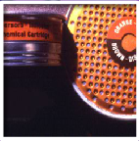
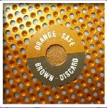
APR Limitations
Cannot be used in IDLH atmospheres
Cannot be used in oxygen deficient atmospheres
The chemicals of concern must be known, to allow selection of the appropriate cartridges
The concentration must be known, to prevent the use in IDLH situations or at concentrations over the manufacturer limits
Must have and ESLI or must develop a change out policy
Notes:
Some limitations on the use of APRs include:
Cannot be used in IDLH atmospheres
Cannot be used in oxygen deficient atmospheres
The chemicals of concern must be known, to allow selection of the appropriate cartridges
The concentration must be known, to prevent the use in I.D.L.H. situations or at concentrations over the manufacturer limits, and
Must have and E.S.L.I. or must develop a change out policy

Slide 41
Thank you!
Questions?

