Slide 1
Hospital Preparedness Program (HPP) Budget Period 4 (BP4) Burn Surge TTX Tabletop Exercise
Final Planning Meeting
Date: January 18, 2023, 11:00 AM

Slide 2
Welcome!

Slide 3
Outline – Meeting Agenda
Welcome
Trusted Agents
Exercise Director - Ari Rubinstein – NYC DOHMH
Exercise Planning Team Leader – David Miller– NYC DOHMH
This project was supported by the Department of Health and Human Services’ Administration for Strategic Preparedness and Response under award number 6U3REP190597-04. Its content is solely the responsibility of the authors and does not necessarily represent the official views of the Department of Health and Human Services’ Administration for Strategic Preparedness and Response.

Slide 4
Trusted Agents
Trusted agents (Steering Committee / Exercise Planning Team) - are trusted not to reveal exercise and scenario details to players or third parties before exercise conduct.
Develop pre-exercise materials, conduct exercise briefings, and support training sessions.
Information in this document is intended for the exclusive use of the exercise planners and is not to be released to the public or other personnel who do not have a valid need-to-know without prior approval from an authorized sponsor organization representative.
This document is not releasable to any public website.

Slide 5
Meeting Objectives
Exercise Design
Review and approve all draft exercise material
Exercise Development
Understand and approve exercise processes and procedures
Ensure all logistical requirements are met
Discuss next steps and assign tasks

Slide 6
Planning Updates

Slide 7
Planning updates
Outcomes of the Midterm Planning Meeting
Comments have been addressed in FPM Document
Please continue to submit comments to IPM, MPM, and FPM as contractually required
Additional updates

Slide 8
Exercise Design

Slide 9
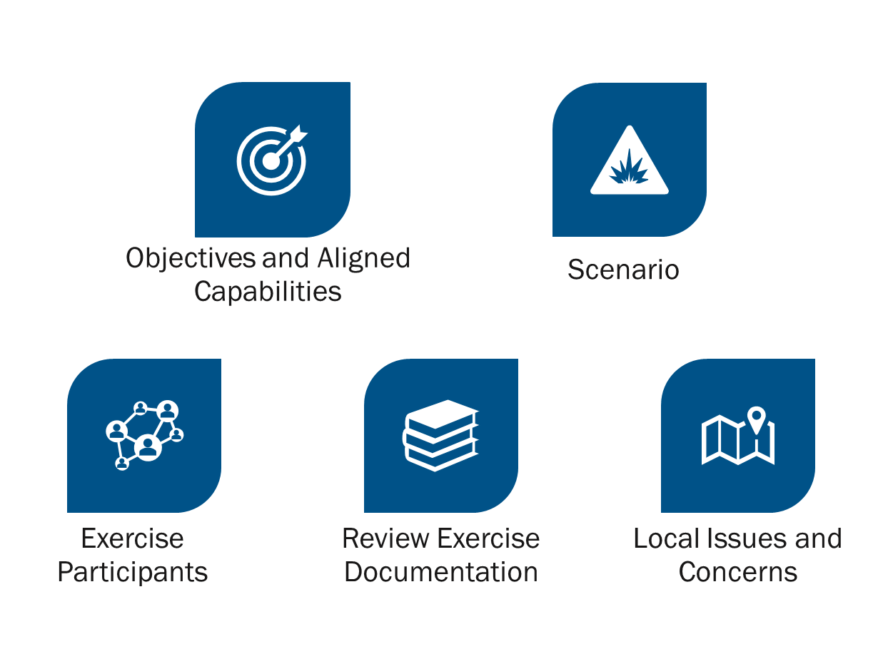
Exercise Design Discussion Points

Slide 10
Exercise Objectives
ASPR Capability #4: Medical Surge
Health care organization-including hospitals, EMS, and out-of-hospital providers - deliver timely and efficient care to their patients even when the demand for health care services exceeds available supply. The HCC, in collaboration with the ESF-8 lead agency, coordinates information and available resources for its members to maintain conventional surge response. When an emergency overwhelms the HCC’s collective resources, the HCC supports the health care delivery system’s transition to contingency and crisis surge response and promotes a timely return to conventional standards of care as soon as possible.

Slide 11
Exercise Objectives
Objectives align to ASPR Capability #4: Medical Surge
Objective #1
Validate the ability of the HCC members to activate their Mass Casualty Plans within the first 12 hours in accordance with the NYC HCC Burn Surge Annex.
Objective #2
Identify methods that HCC members will employ to triage and prioritize patients for treatment or transfer to specialty facilities within the first 12 hours in accordance with the NYC HCC Burn Surge Annex.
Objective #3
Discuss how HCC members will coordinate during the response when clinical resources are strained or depleted within 2 hours of the onset of the incident or arrival of patients in accordance with the NYC HCC Burn Surge Annex.

Slide 12
Scenario
On a Summer Saturday, thousands of attendees gather on Randall’s Island beginning at 11 AM for the NYC Circus. At approximately 4:00 PM (1600), the stage display catches on fire. Initially, it is unknown whether this is caused by pyrotechnic failure or electrical fire. Due to high winds, the fire spreads and ultimately results in a stage collapse. Initial patients experience burn and crush injuries. The crowd evacuates rapidly leading to additional crush/trample injuries near the stage and exits. As the fire spreads, a nearby dining tent is engulfed and results in minor burns from flames and cooking oil. After evacuation, of the impacted area, patients are treated, triaged, and transported to nearby hospitals.

Slide 13
Exercise Participants
BronxCare Health System
Calvary Hospital
Hospital for Special Surgery
Maimonides Medical Center
Memorial Hospital for Cancer and Allied Diseases (MSKCC)
New York Community Hospital
Richmond University Medical Center
St. Barnabas Hospital
St. John's Episcopal Hospital
The Brooklyn Hospital Center
University Hospital of Brooklyn - SUNY Downstate Medical Center
Wyckoff Heights Medical Center
NYC Health + Hospitals
Montefiore Health System
Medisys Health Network
FDNY
Northwell Health
NewYork-Presbyterian Healthcare System
Mount Sinai Health System
NYU Langone Health
One Brooklyn Health System
Pediatric Disaster Coalition
Community Healthcare Organization of New York State
North HELP Coalition (Mt. Sinai Hospital)
Greater New York Hosptial Association - Continuting Care (GNYHA-CC)
The Audacia Foundation Inc. on behalf of Southern New York Association (SNYA)
Greater New York Healthcare Facility Association (GNYHCFA)
New York State Association of Healthcare Providers, Inc.
Home Care Association of New York State (NYS HCA)
Hospice and Palliative Care Association
Greater New York Hospital Association
NYCEM

Slide 14
Review Exercise Documentation
Situation Manual (SitMan)
Controller/Evaluator (C/E) Handbook
EEGs
Presentation
Participant Feedback Form

Slide 15
Exercise Development

Slide 16
Exercise Development Discussion Points
Exercise Logistics
Exercise Schedule
Exercise Staffing
Exercise Planning Timeline

Slide 17
Discussion
Confirm all exercise logistical arrangements
TEAMS
Finalize exercise schedule
Finalize exercise staffing requirements (Suggest 1 each)
Facilitator
Controllers
Evaluators
Scribe
Finalize exercise planning timeline

Slide 18
Exercise Schedule
Event | Date | Time
Controller/Evaluator Brief | 2/15/23 | 1 PM
Participant Registration | By invitation
Participant Brief | 2/16/23 | 10 AM
Workshop | 2/16/23 | 10 AM – 12PM
Start of Exercise (StartEx) |  | 1 PM
End of Exercise (EndEx) | 2/16/23 | 2:30 PM
Hotwash (Quick) | 2/16/23 | 2:35 PM

Slide 19
Exercise Staffing
Exercise control
Lead or Senior Controller: Name / NYC DOHMH
Safety Controller: Name / Organization
Exercise evaluation
Lead Evaluator: Name / NYC DOHMH
3 Evaluators (1 for each EEG)
Site / Function specific evaluators, as needed
Subject-Matter Experts (SMEs)
Any identified SMEs
Other Staff as needed

Slide 20
Exercise Planning Timeline
Event | Date | Time
Exercise | 2/16/2023 | 10 AM – 12 PM 1 PM – 3 PM
After-Action Meeting | 3/1/2023 | 10 AM – 11:30 AM
Draft AAR | 3/15/2023
Final AAR/IP due | 4/21/2023

Slide 21
Outstanding Issues
Any outstanding issues to address

Slide 22
Conclusion

Slide 23
Action Items
Distribute FPM meeting minutes – Exercise Director, January 25, 2023
Provide feedback on FPM meeting document (word with tracked changes) – January 31, 2023
Finalize and distribute exercise documentation, Exercise Director, February 7, 2023
Finalize logistics: Exercise Director, February 10, 2023
[Additional action items]

Slide 24
Next Meetings
Exercise
Date: February 16, 2023
Time: Workshop 10am – 12pm / Exercise 1pm – 3pm
Location: Virtual – Teams
Registration: Teams Meeting invite with Registration information previously sent
After registering you will receive a confirmation email containing information about joining the webinar
Draft AAR/IP due March 15, 2023
Hotwash / After Action Meeting
Date: March 1, 2023
Time: 10am - 11:30am
Location: Virtual – Teams
Registration: Teams Meeting invite with Registration information previously sent
After registering you will receive a confirmation email containing information about joining the webinar

Slide 25
QUESTIONS

Slide 26
Thank you!
See you at the Exercise!

