Slide 1
Hospital Preparedness Program (HPP) Budget Period 4 (BP4) Burn Surge TTX “Feel the burn” Tabletop Exercise
Concept and Objectives Meeting
Date: October 17, 2022, 11:00 a.m.

Slide 2
Welcome!

Slide 3
Outline – Meeting Agenda
Welcome
Trusted Agents
Introduction and Goals
Exercise Design
Exercise Planning
Action Items and Next Steps
This project was supported by the Department of Health and Human Services’ Administration for Strategic Preparedness and Response under award number 6U3REP190597-04. Its content is solely the responsibility of the authors and does not necessarily represent the official views of the Department of Health and Human Services’ Administration for Strategic Preparedness and Response.

Slide 4
Trusted Agents
Trusted agents (Steering Committee / Exercise Planning Team) - are trusted not to reveal exercise and scenario details to players or third parties before exercise conduct.
Develop pre-exercise materials, conduct exercise briefings, and support training sessions.
Information in this document is intended for the exclusive use of the exercise planners and is not to be released to the public or other personnel who do not have a valid need-to-know without prior approval from an authorized sponsor organization representative.
This document is not releasable to any public website.

Slide 5
Introduction and Goals
Introduction
Exercise Director, Nicole Marks, CEM, MEP - NYC DOHMH
Exercise Planning Team Leader, Ari Rubinstein - NYC DOHMH
Goals
Exercise Design
Define exercise concept and scope
Propose Exercise Objectives and Capabilities
Participants and extent of play
Exercise Planning
Exercise planning team and Steering committee responsibilities
Exercise planning team members and Steering Committee members
Exercise planning timeline
Next steps and tasks

Slide 6
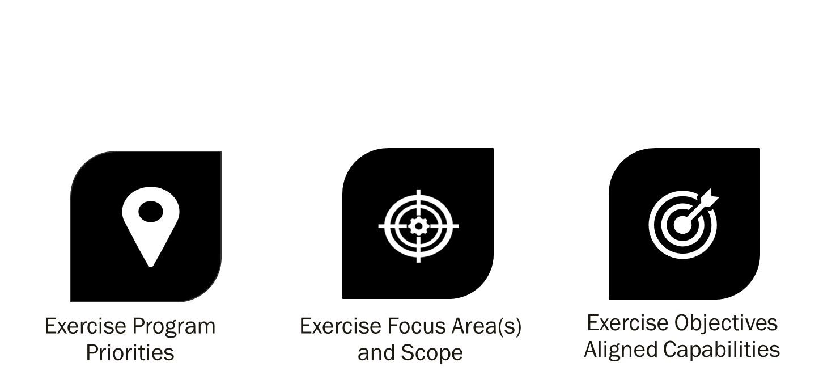
Exercise Design Discussion Points

Slide 7
Exercise Program Priorities
Administration for Strategic Preparedness and Response (ASPR) – healthcare readiness
Hospital Preparedness Program (HPP) – Health care system preparedness and response / health care coalitions (HCCs)
Project period for five years (July 2019 to June 2024)
Current Annual Award - Budget Period 4 (BP4) July 1, 2022 – June 30, 2023
BP4 requirements include
TTX for surge annex (or real-world incident) - HCC Burn Surge Annex was completed in March 2022

Slide 8
Exercise Focus Areas and Scope
Focus Areas
Preparedness / Planning
Response
Exercise Scope
Type: Tabletop Exercise (TTX) with a workshop component
Duration: 3-4 hours
Location: Virtual (facilities can choose on site play)
Parameters / Extent of play: Discussion based activities will be focused on response play with a burn scenario surging 20% of bed capacity
Participants: Hospitals and health care facilities, government and community partners and NYC DOHMH staff

Slide 9
Objectives and Capabilities

Slide 10
Objectives and Capabilities
Exercise objectives are the distinct outcomes that we wish to achieve during this exercise
Number of objectives will be reasonable
SMART objectives facilitate effective scenario design, exercise conduct, and evaluation
Exercise capabilities are the means to accomplish a mission, function, or objective based on the performance of related tasks under specified conditions to target levels of performance

Slide 11
SMART Guidelines for Exercise Objectives

Slide 12
Proposed Exercise Objectives
The exercise planning team aligns each exercise objective to one or more capabilities
Aligning objectives to a common set of capabilities enables:
Systematic tracking of progress
Standardized exercise data collection
Fulfillment of grant funding requirements
Linking objectives to capabilities supports the development of capability targets to be met during the exercise, with associated critical tasks.

Slide 13
Proposed Exercise Objectives
ASPR Capability #4: Medical Surge
Health care organization-including hospitals, EMS, and out-of-hospital providers - deliver timely and efficient care to their patients even when the demand for health care services exceeds available supply. The HCC, in collaboration with the ESF-8 lead agency, coordinates information and available resources for its members to maintain conventional surge response. When an emergency overwhelms the HCC’s collective resources, the HCC supports the health care delivery system’s transition to contingency and crisis surge response and promotes a timely return to conventional standards of care as soon as possible.

Slide 14
Proposed Exercise Objectives
Objectives align to ASPR Capability #4: Medical Surge
Objective #1
Validate the ability of the HCC members to activate their Mass Casualty Plans within the first operational period in accordance with the NYC HCC Burn Surge Annex.
Objective #2
Identify methods that HCC members will employ to triage and prioritize patients for treatment or transfer to specialty facilities within the first operational period in accordance with the NYC HCC Burn Surge Annex.
Objective #3
Discuss how HCC members will coordinate during the response when clinical resources are strained or depleted within two hours of the onset of the incident or arrival of patients in accordance with the NYC HCC Burn Surge Annex.

Slide 15
Exercise Planning

Slide 16
Exercise Planning Discussion Points
Planning Team Responsibilities and Members
Steering Committee Responsibilities and Members
Planning Timeline and Milestones

Slide 17
Exercise Planning Team Responsibilities
Exercise Director: oversees all functions during exercise conduct
Exercise Planning Team Leader: coordinates all exercise planning activities
Design and Development: responsible for compiling and developing all exercise background and facilitation or control for the exercise.
Evaluation: Responsible for the development of the overall exercise evaluation construct and all evaluation documentation.
Resource Support: Responsible for the logistics, administration, facility, and finance support for planning meetings, exercise documentation and other planning considerations

Slide 18
Exercise Planning Team Responsibilities
Attend and participate in the Steering Committee Meetings
Meetings will be held prior to the exercise planning meetings
Provide input and feedback for the following:
Design, Development and Evaluation – exercise objectives, background, facilitation and/or control, and evaluation
Resource Support if needed
Review meeting documents and submit comments
Design, Development and Evaluation – exercise objectives, background, facilitation and/or control, and evaluation
Resource Support if needed

Slide 19
Planning Team Members and Steering Committee Members
Planning Team Members:
Exercise Director: Nicole Marks
Planning Team Lead: Ari Rubinstein
Members: Matthew Curran
Jimmy Dumancela
Dr. Mary Foot
Nia Johar
Michael McCollum
David Miller
Dr. Darrin Pruitt
Chanukka Smith
Danielle Sollecito
Marsha Williams
Steering Committee Members (invited):
NYCEM
FDNY
NYS Department of Health
NYU Langone
Richmond University Medical Center
RWJ Barnabas Health
Greater NY Hospital Association
Jamaica Hospital Medical Center
SUNY Downstate
REMSCO
NYC HHC
CHCANYS
PDC

Slide 20
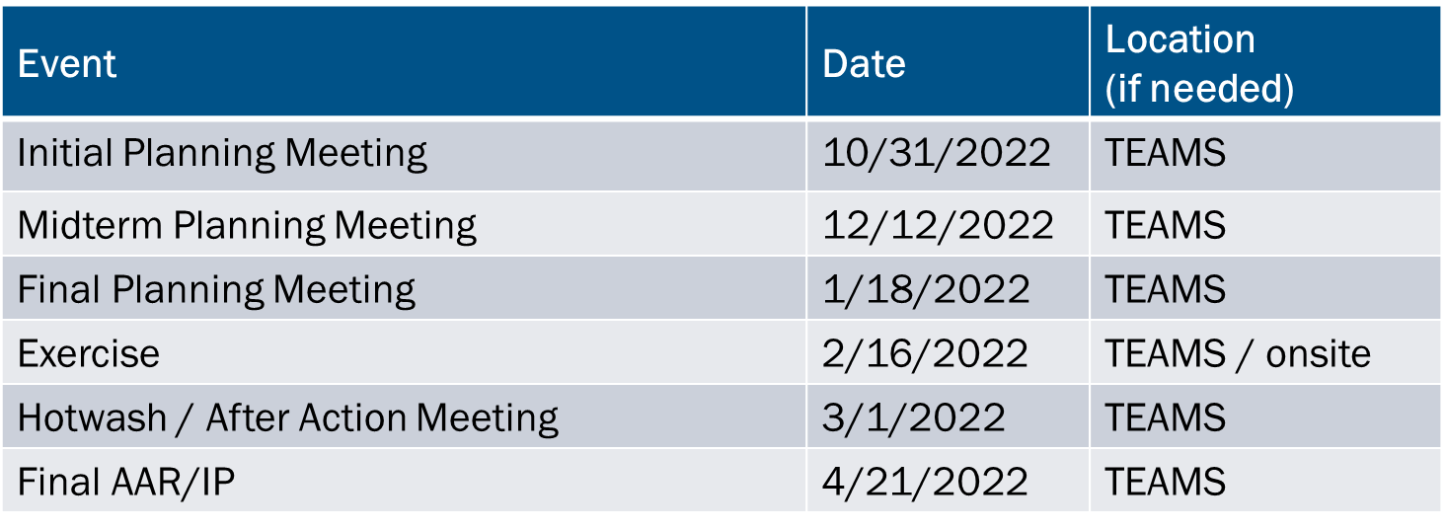
Exercise Planning Timeline

Slide 21
Conclusion

Slide 22
Action Items
Distribute C&O meeting minutes – Exercise Director, October 21, 2022
Provide feedback on C&O meeting document (word with tracked changes) - Exercise Planning Team and Steering Committee, October 24, 2022
Develop draft exercise materials
Potential injects
Exercise Plan
Controller and Evaluator Handbook
Participant Feedback Forms

Slide 23
Next Meetings
Steering Committee Meeting
Date: October 31, 2022
Time: 10am – 12pm
Location: Virtual – Teams
Registration: Teams Meeting invite with Registration information to follow
After registering you will receive a confirmation email containing information about joining the webinar
Initial Planning Meeting
Date: October 31, 2022
Time: 10am – 12pm
Location: Virtual – Teams
Registration: Teams Meeting invite with Registration information to follow
After registering you will receive a confirmation email containing information about joining the webinar

Slide 24
QUESTIONS

Slide 25
Thank you!
See you at the Initial Planning Meeting!

